Slide 1
Week five
Applied Data engineering
Sagemaker ML

Slide 2
Domain
Role
S3 bucket
Sagemaker (python notebook)
model creation
end point generation
testing
housekeeping.

Slide 3
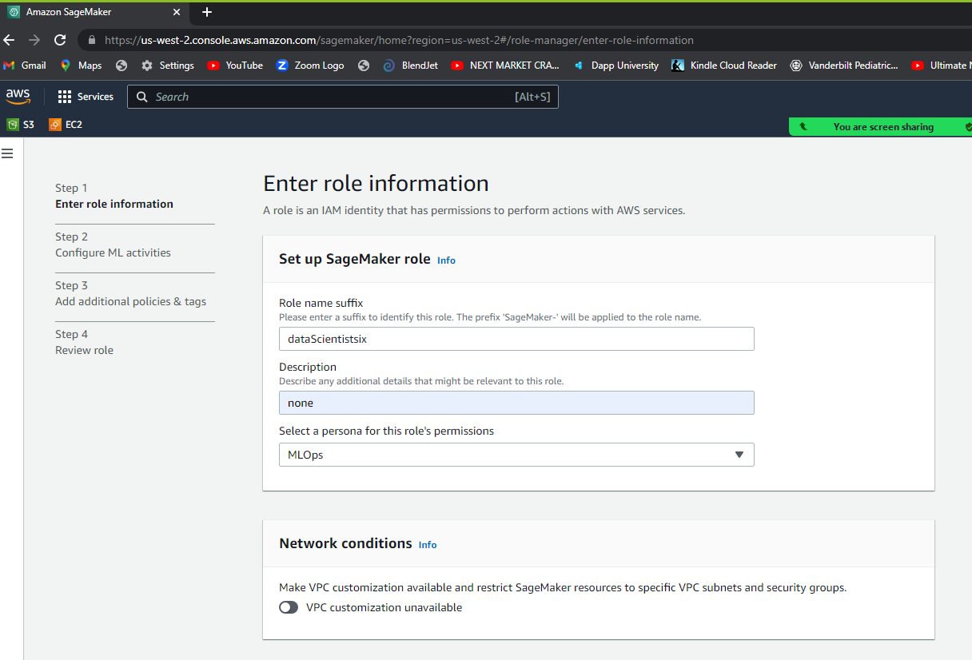

Slide 4
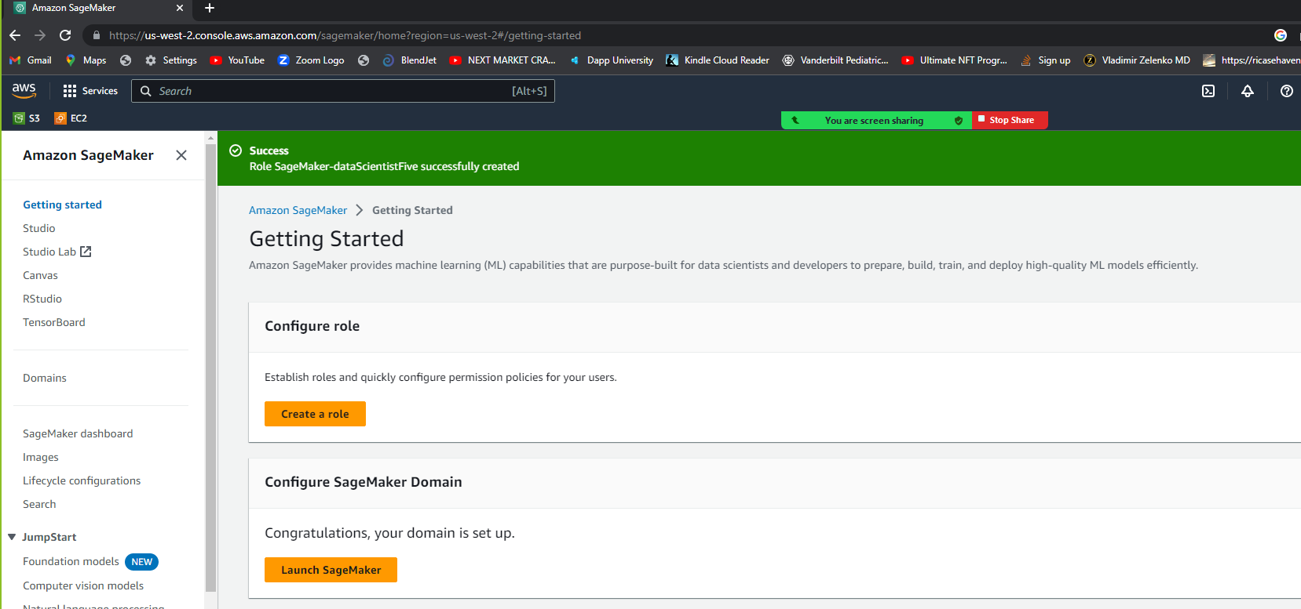
“getting started”

Slide 5
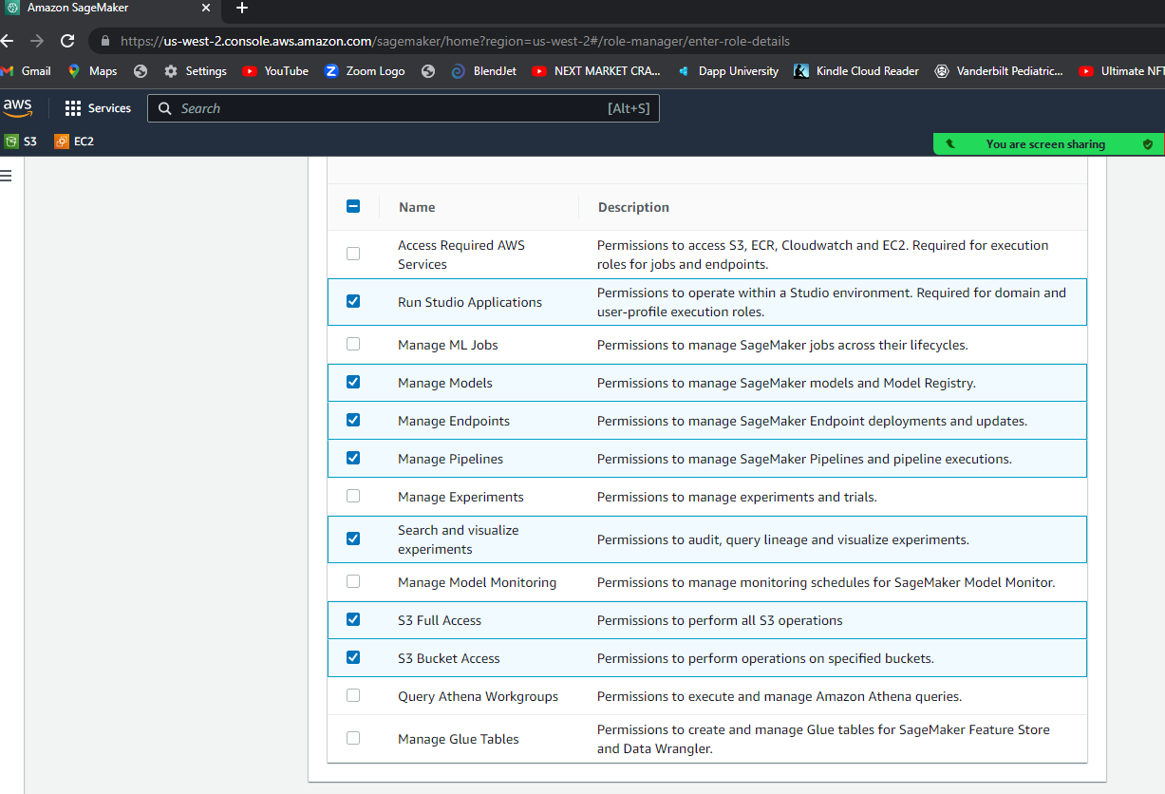
I added this !!!!!

Slide 6
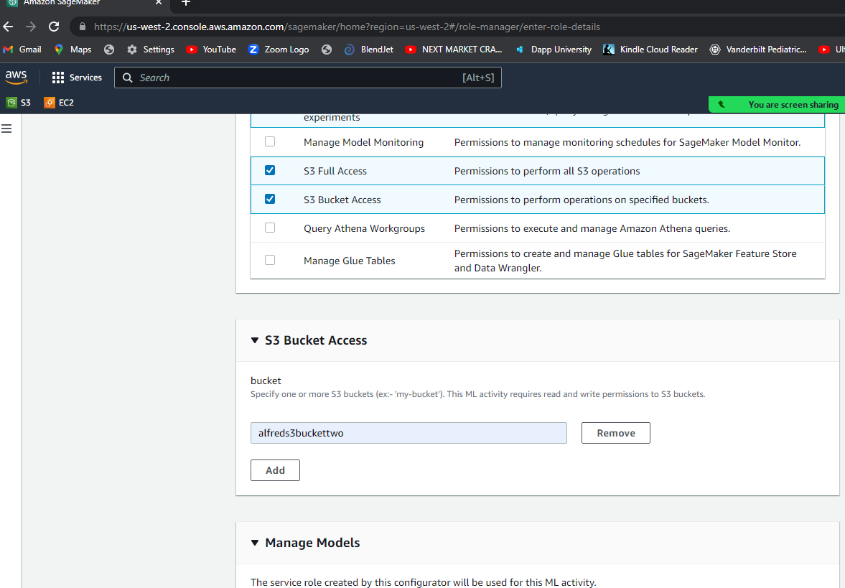

Slide 7
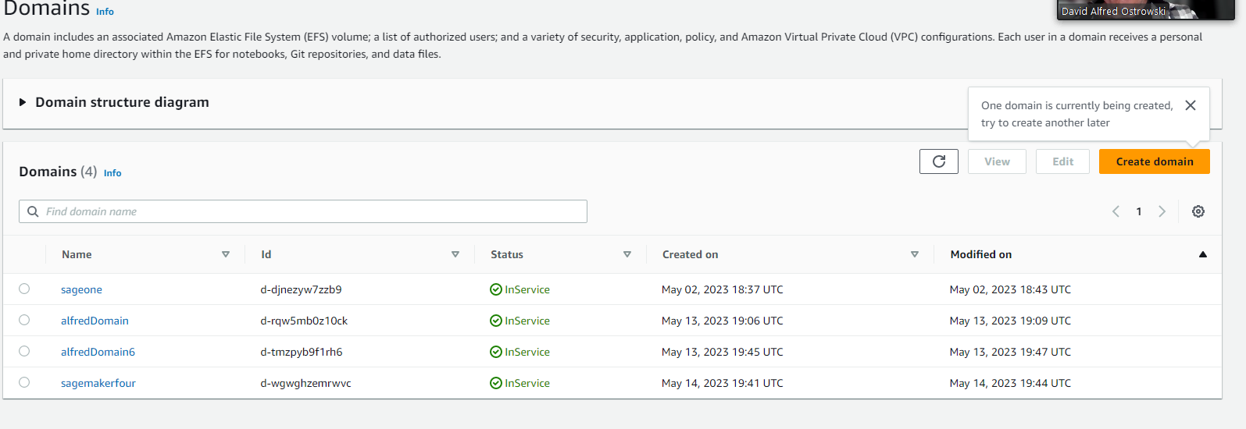

Slide 8
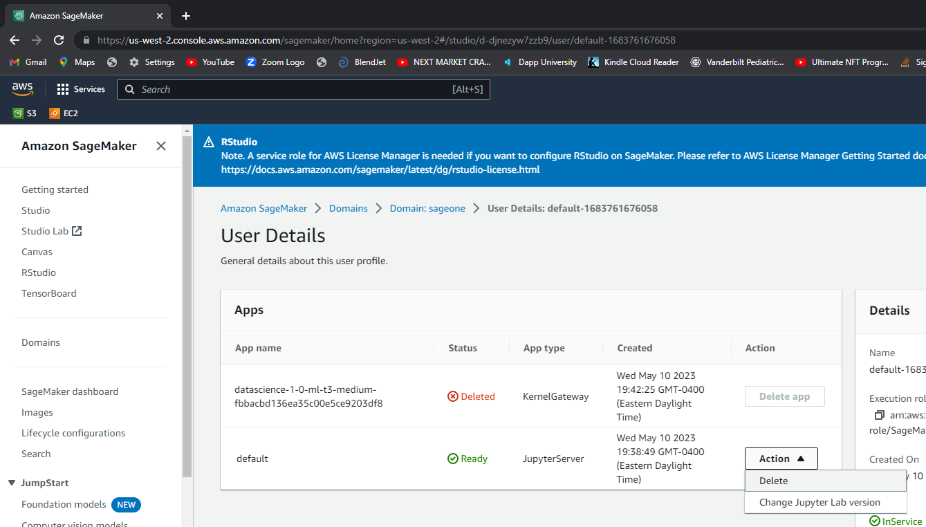
You have to delete all of your “apps” first
Before you can delete the “default”
Then that will actally

Slide 9
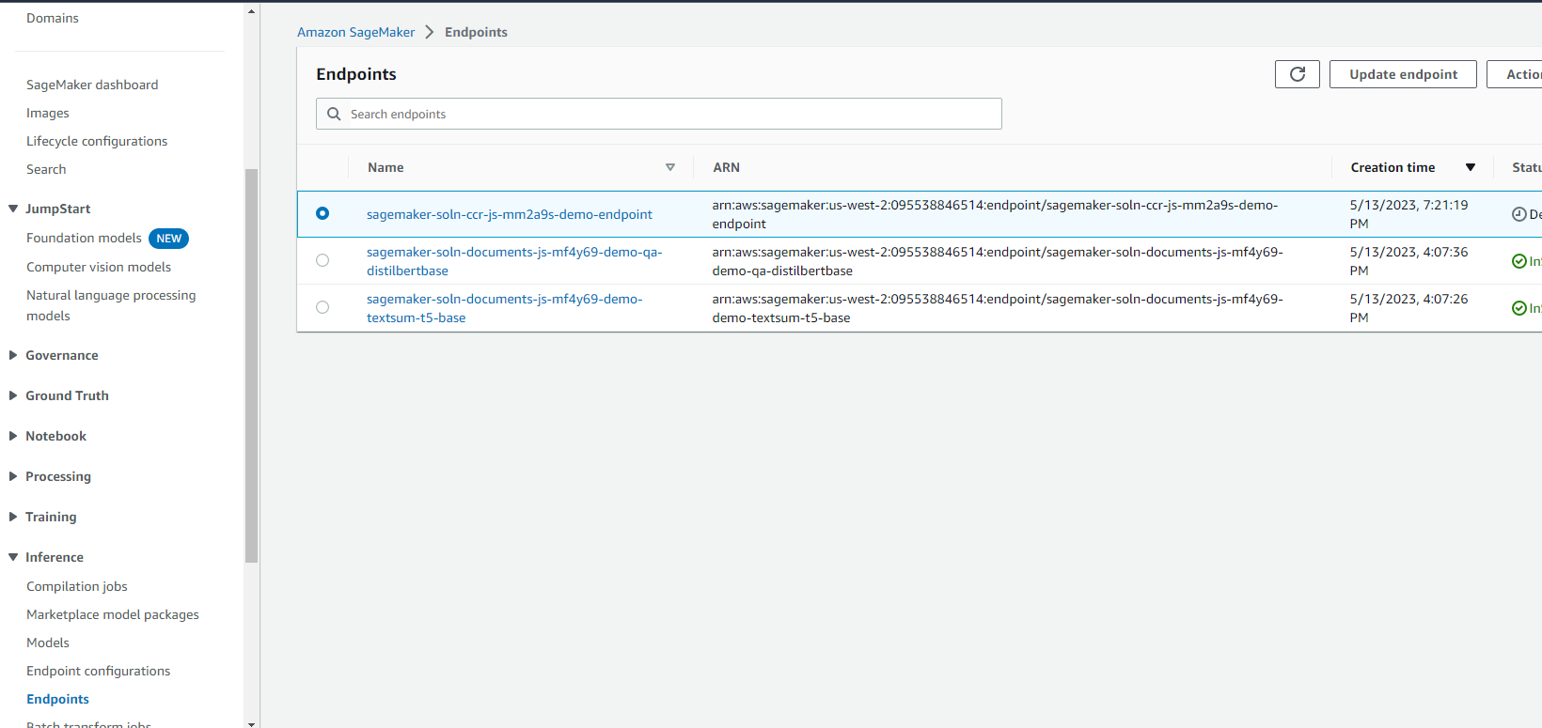

Slide 10
